Slide 1
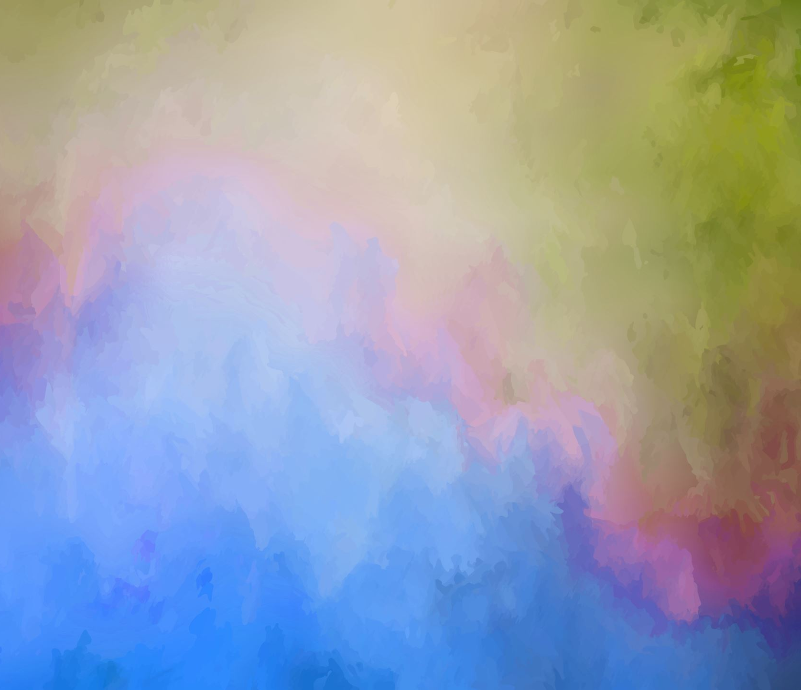
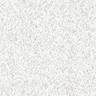
Kinetic Art
By: Silvia Cai

Slide 2
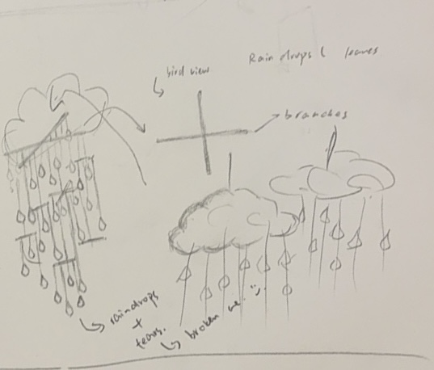
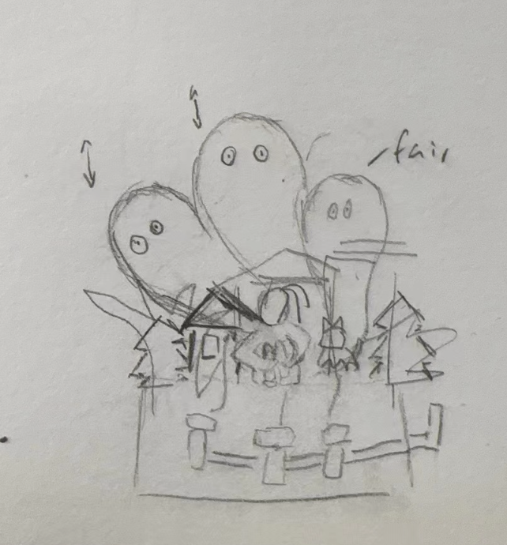
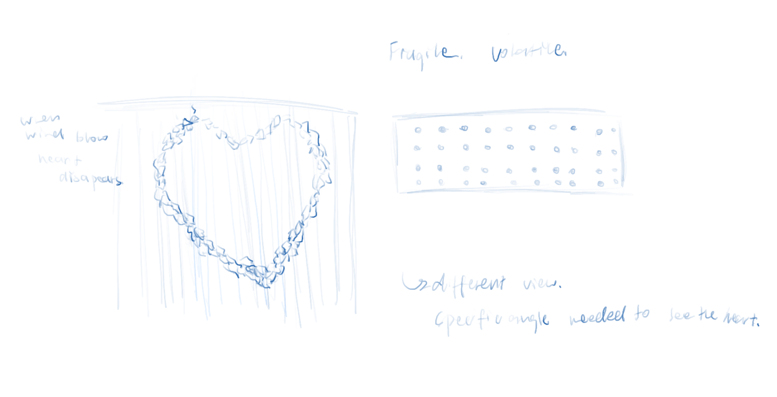
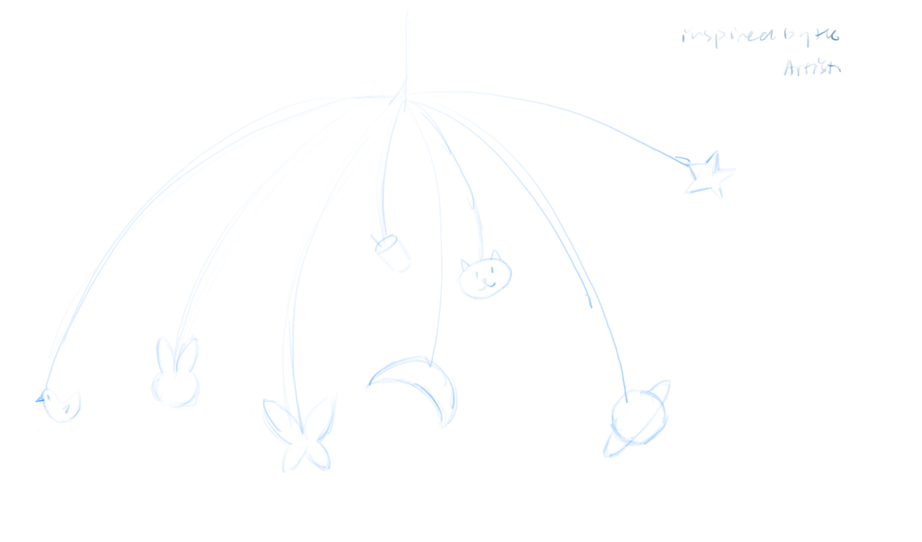
IDEA EXPLORATION
This is my first idea. It is about visuallizing nature and feelings. The rain drops that are falling from the clouds. The drops could also be symbolized as tears that falls off from my eyes. I will also put some clay made 3D eyes on the cloud to make my idea more obvious to catch. Combining feelings with the beauty of nature and the depth of human emotions.
The second idea shows the concept of "scaring oneself" expresses the origin of inner fears. By using mirrors to create the "ghost," the viewer can see their own reflection, symbolizing that these fears are self-created illusions. This allows the viewer to experience an immersive sensation, leading to a deeper understanding of the state of scaring oneself.
Broken pieces of glass, drilled with holes and connected by fishing line. This symbolizes the powerful force of nature and how broken emotions can be reshaped by natural occurrences.
The last idea comes from the artist that I reserched about, where I tried to mimic his style and choice of materials.
I created the artwork by attaching objects from my daily life onto a wire structure. The piece is designed to be turned by the wind, allowing it to move and change, symbolizing the constant flux and flow of everyday experiences.
The viewer is encouraged to move around the artwork, searching for the angle that reveals the complete heart, portraying the idea that healing and wholeness can be found despite the fragility of emotions.

Slide 3
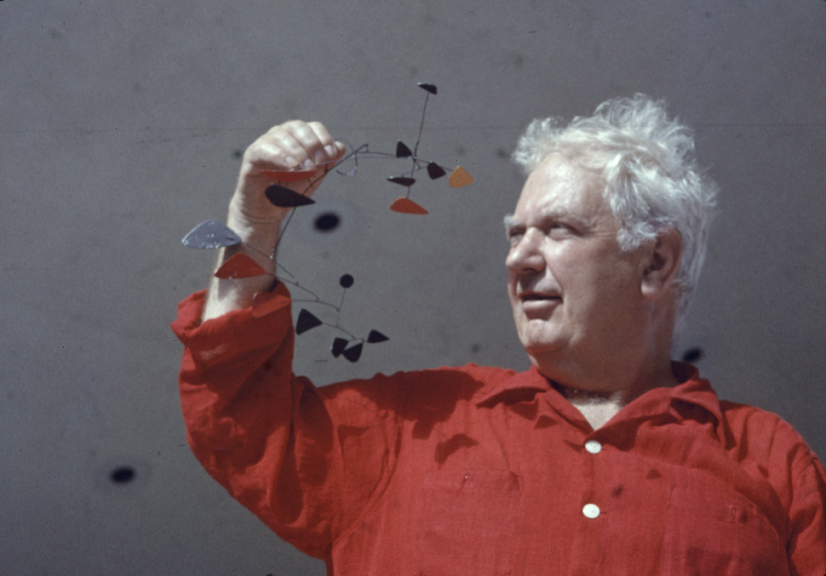
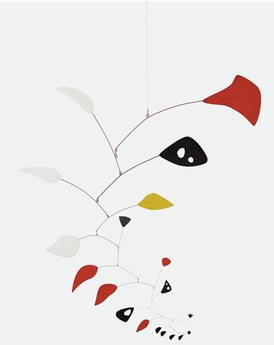
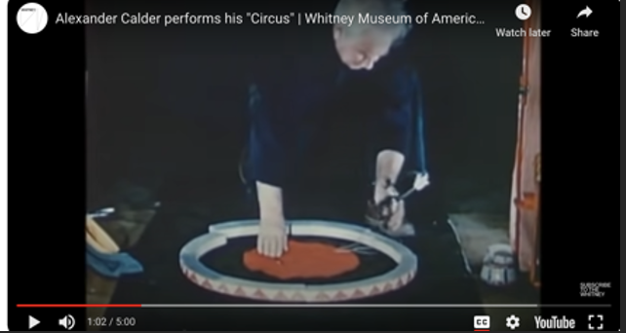
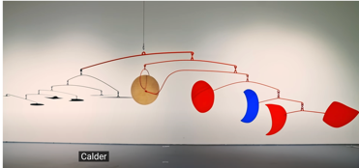
ARTIST RESEARCH
Calder’s artwork have different movements for example the art work “Circus”. The elements in the circus are moved by the wires and performed by artist himself. His understanding and incorporation of movement’s animating force changed modern sculpture from static object to performative presence.
Artist : Alexander Calder use steel aluminum and wire to make kinetic art. He was famous for mobile and stabile. Mobiles means that the artwork are characterized by actuat movement within themselves. While Stabiles are the artworks that require viewers to walk around them to experience the changing perspectives and spacial relationships.
In his work “Mariposa” he brilliantly extracts the crucial elements of form, motion, and color that define the renowned sculptor’s theory and practice. Stopping apparently weightless above the viewer, the nineteen exquisitely cascading elements communicate a sense of limitless kinetic possibility, shifting and rotating to create infinite permutations within the simplest of abstract forms in perfect equilibrium.
Blue moon (wind stand) I saw this artwork presented in a video by Sotheby's. And the feeling this kinetic artwork gives me is one of peace. The piece features different moon shapes centered around a round, gold-colored moon. The gold moon holds the balance and adds weight to the entire artwork. The movement of the moons is controlled by the natural wind. The gentle swaying, combined with the play of light and shadow in the gallery, creates a sense of surrounded by nature as we walk into the artwork.

Slide 4
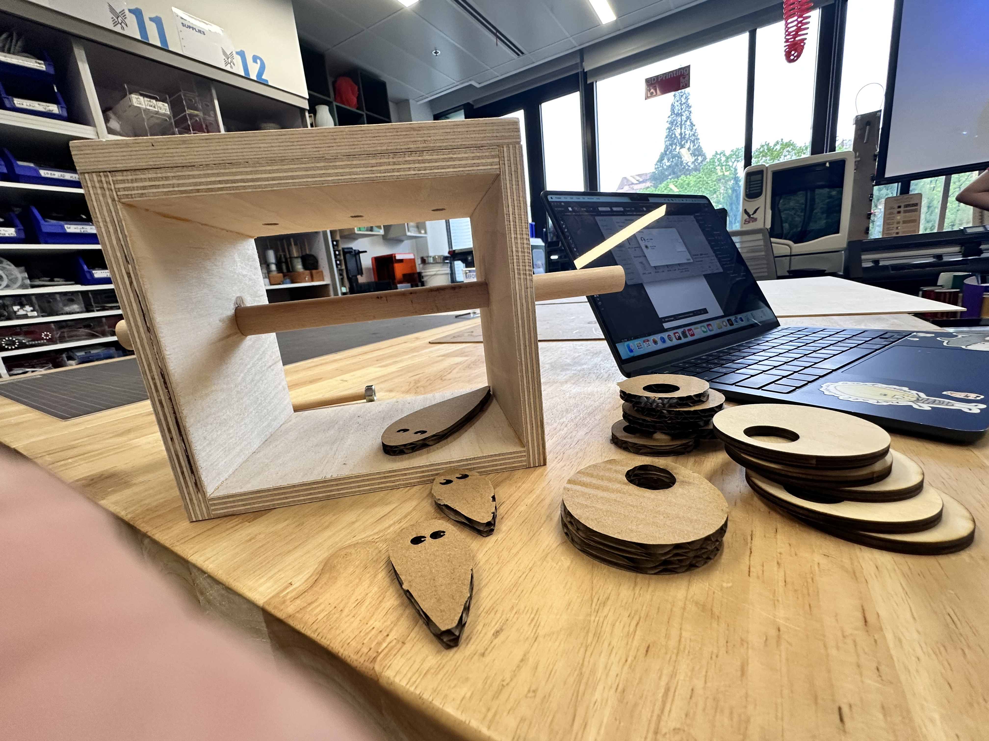
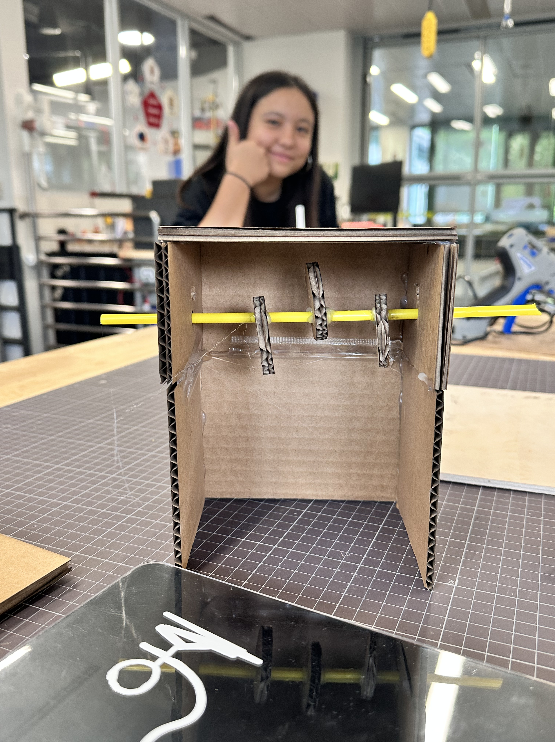
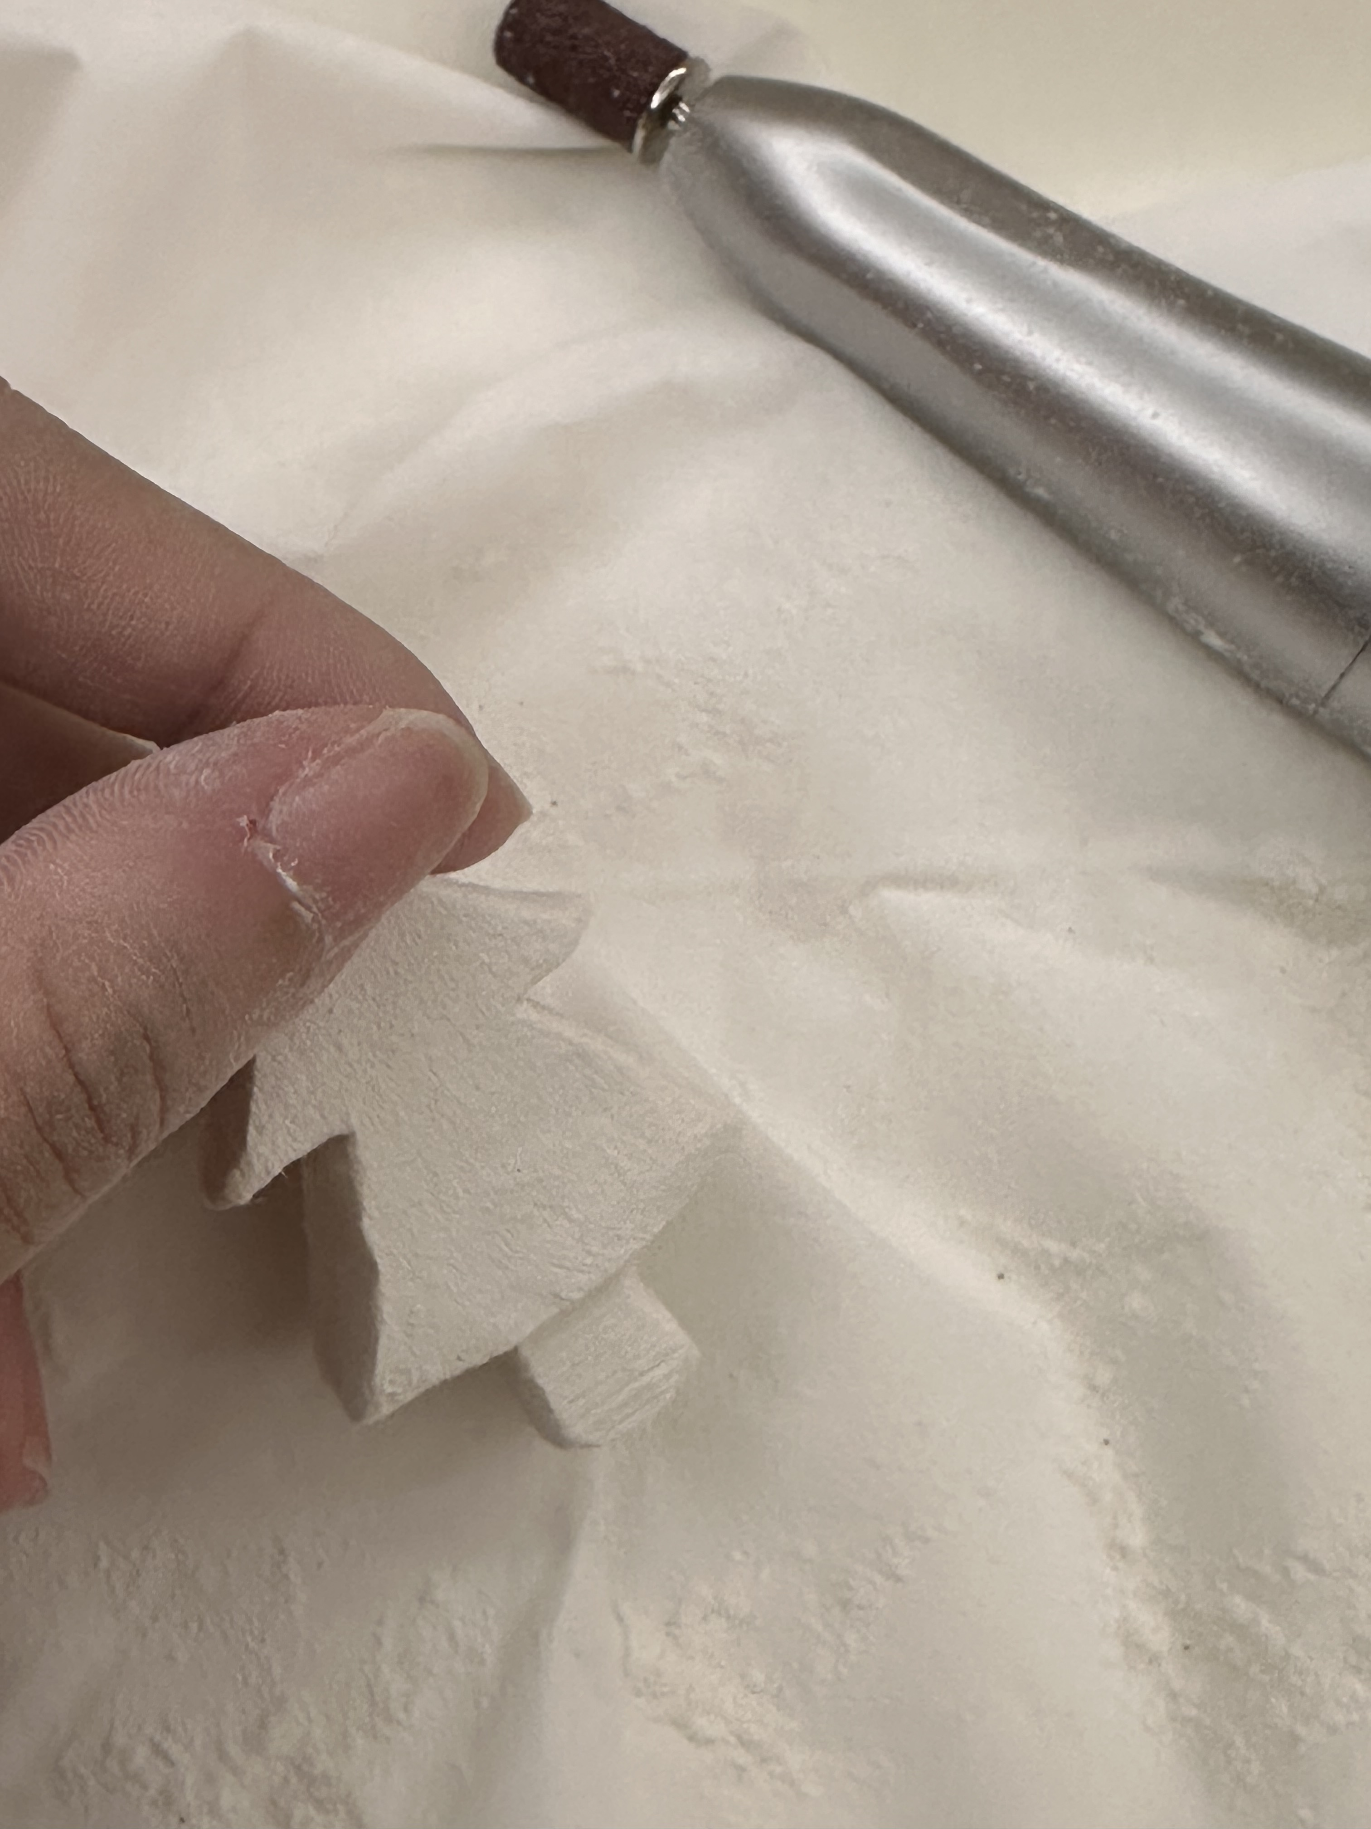
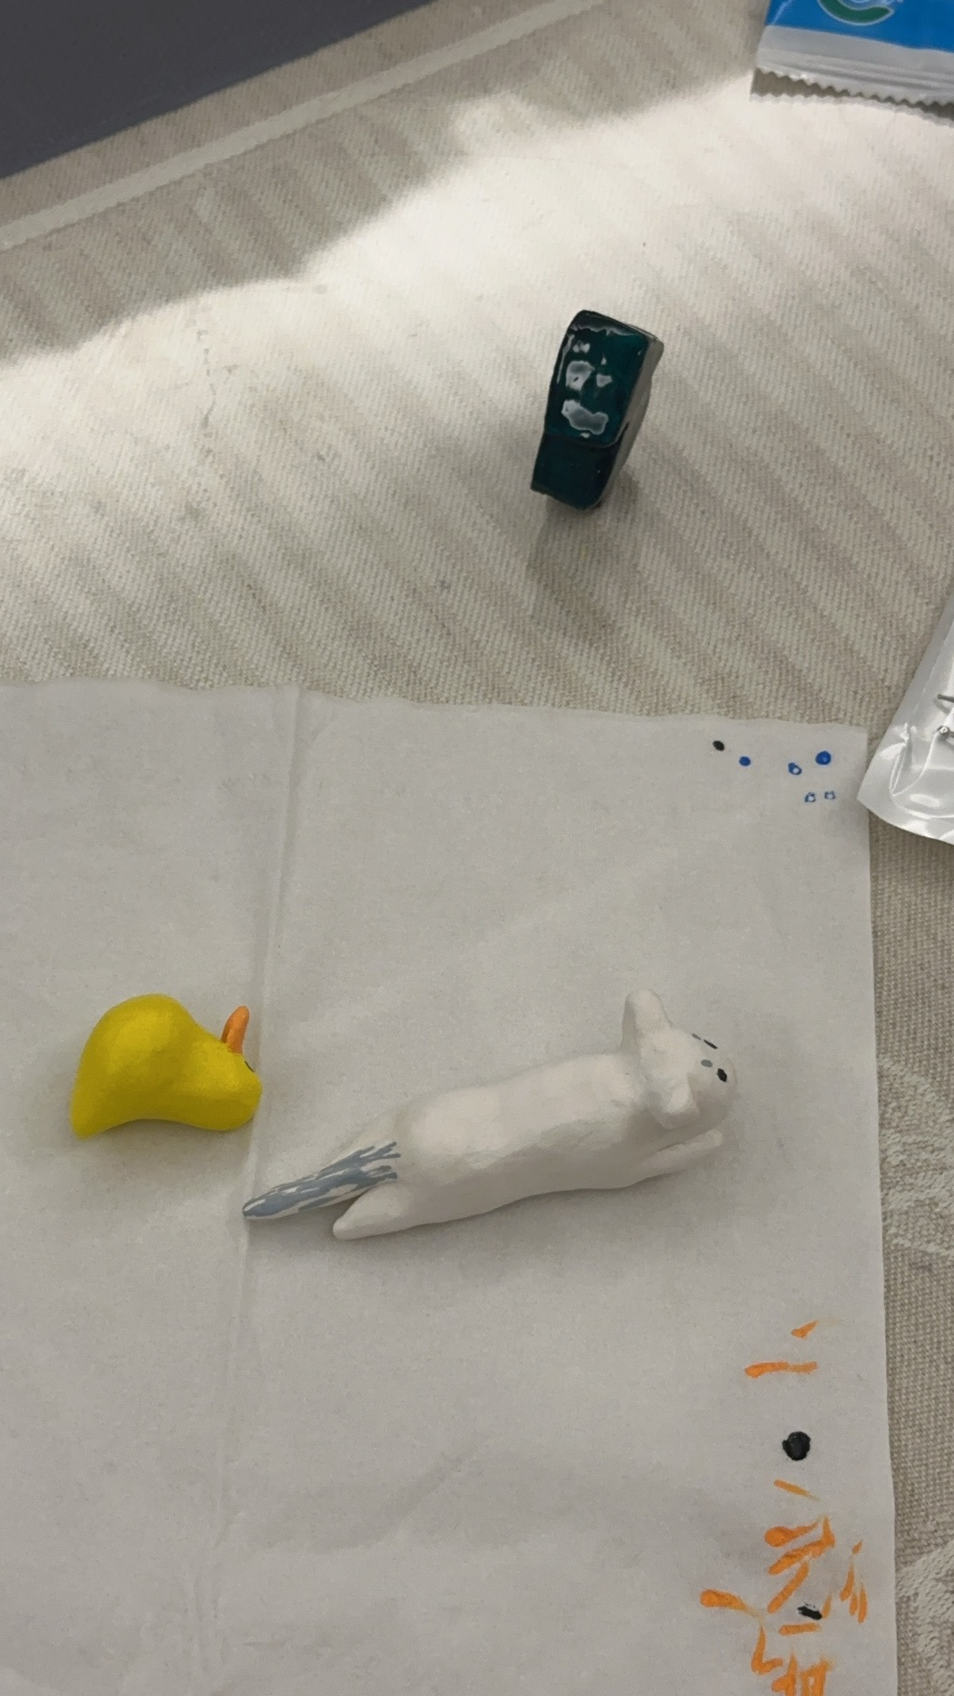
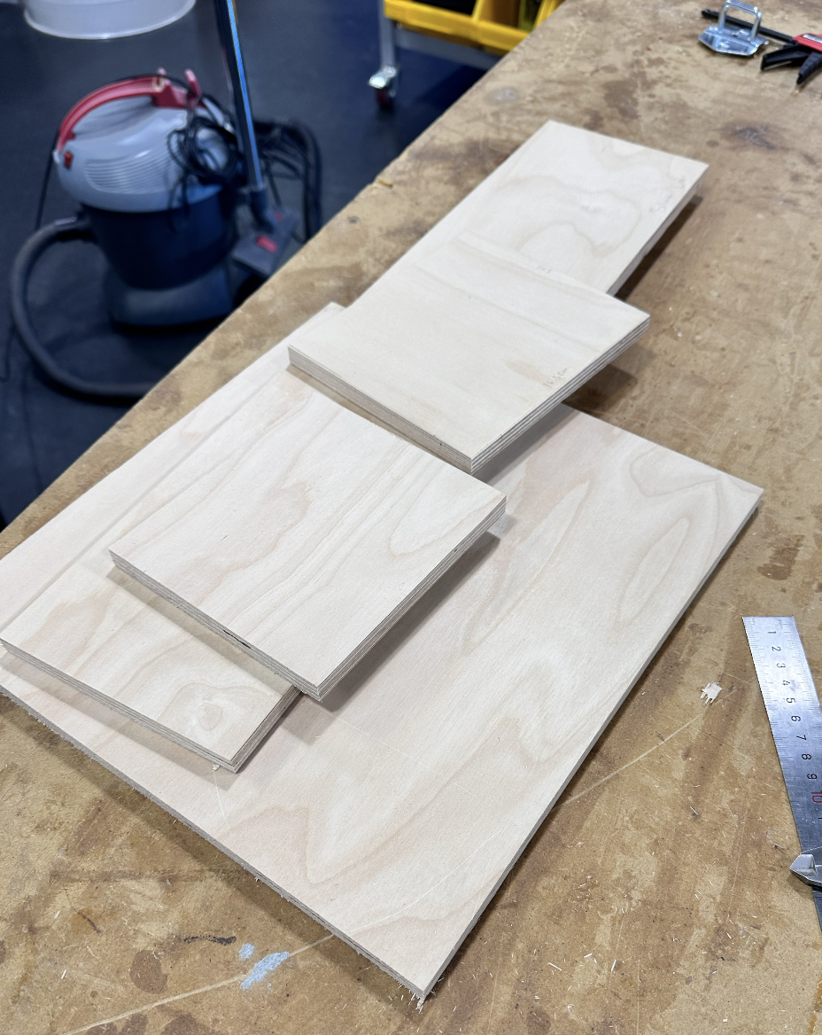
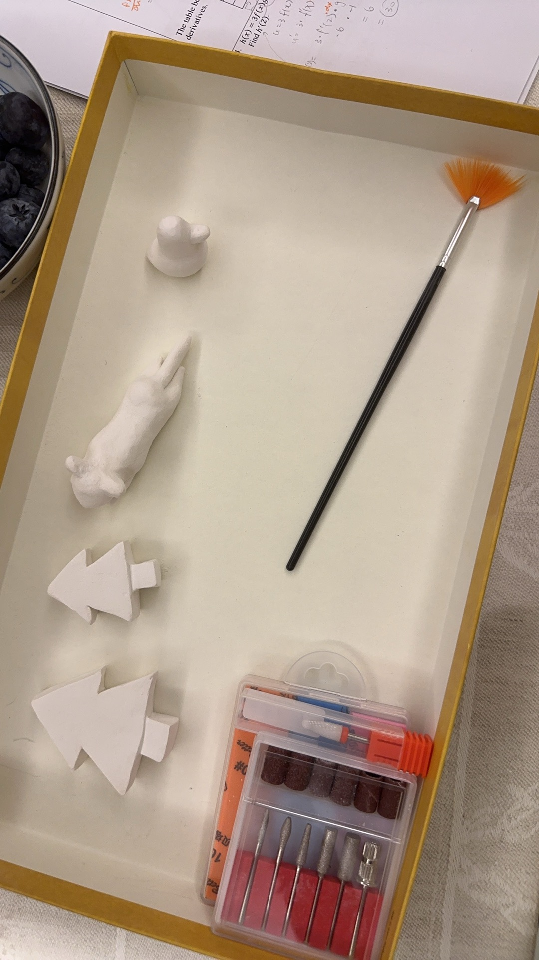
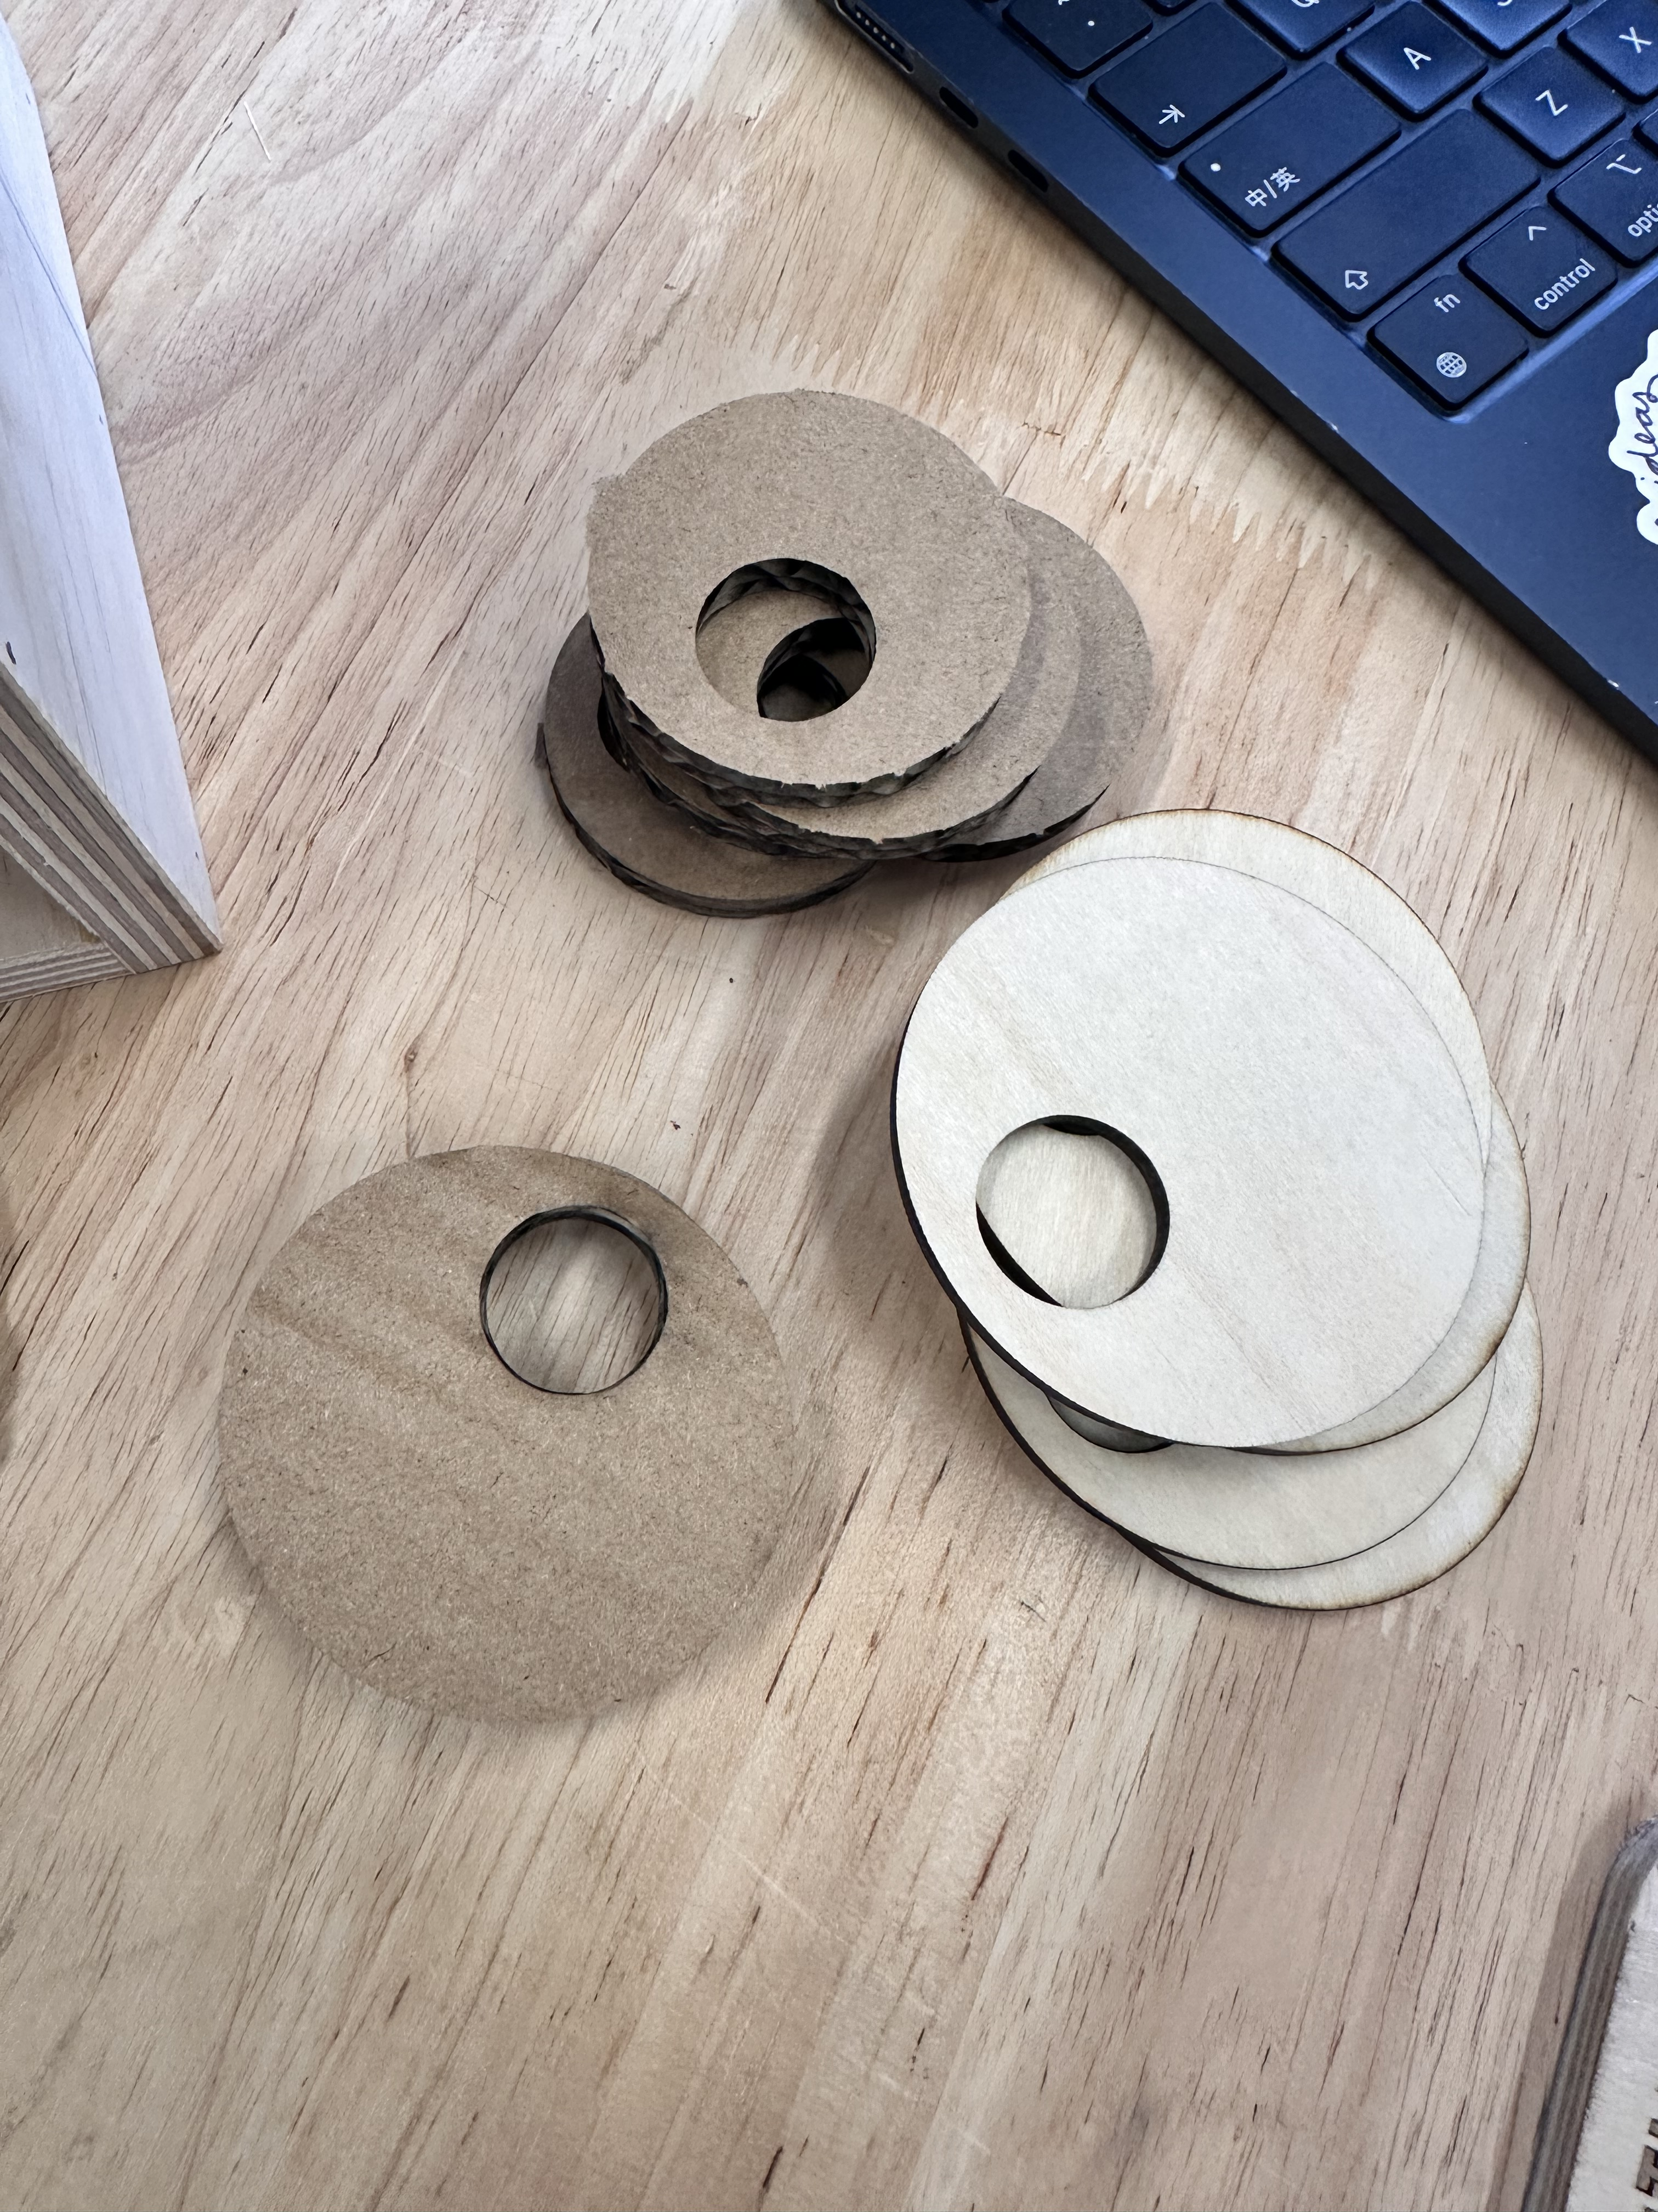
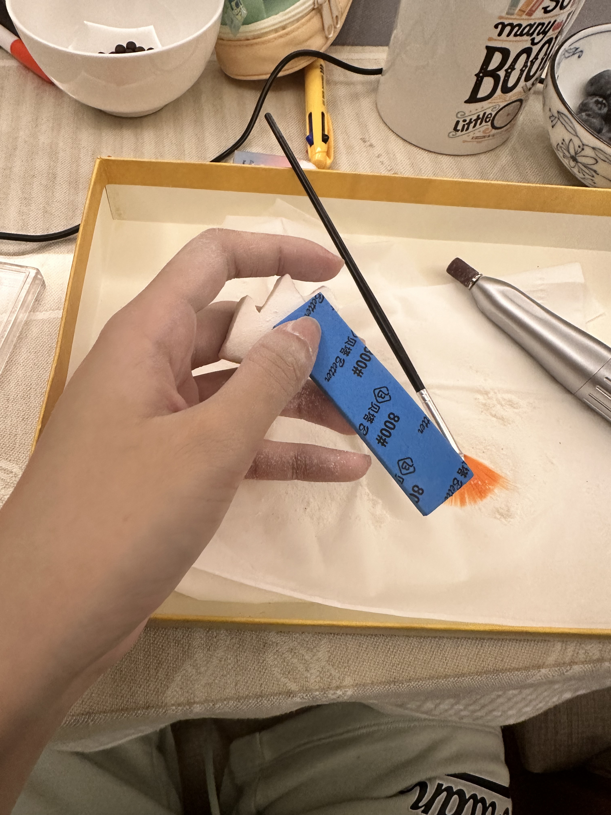
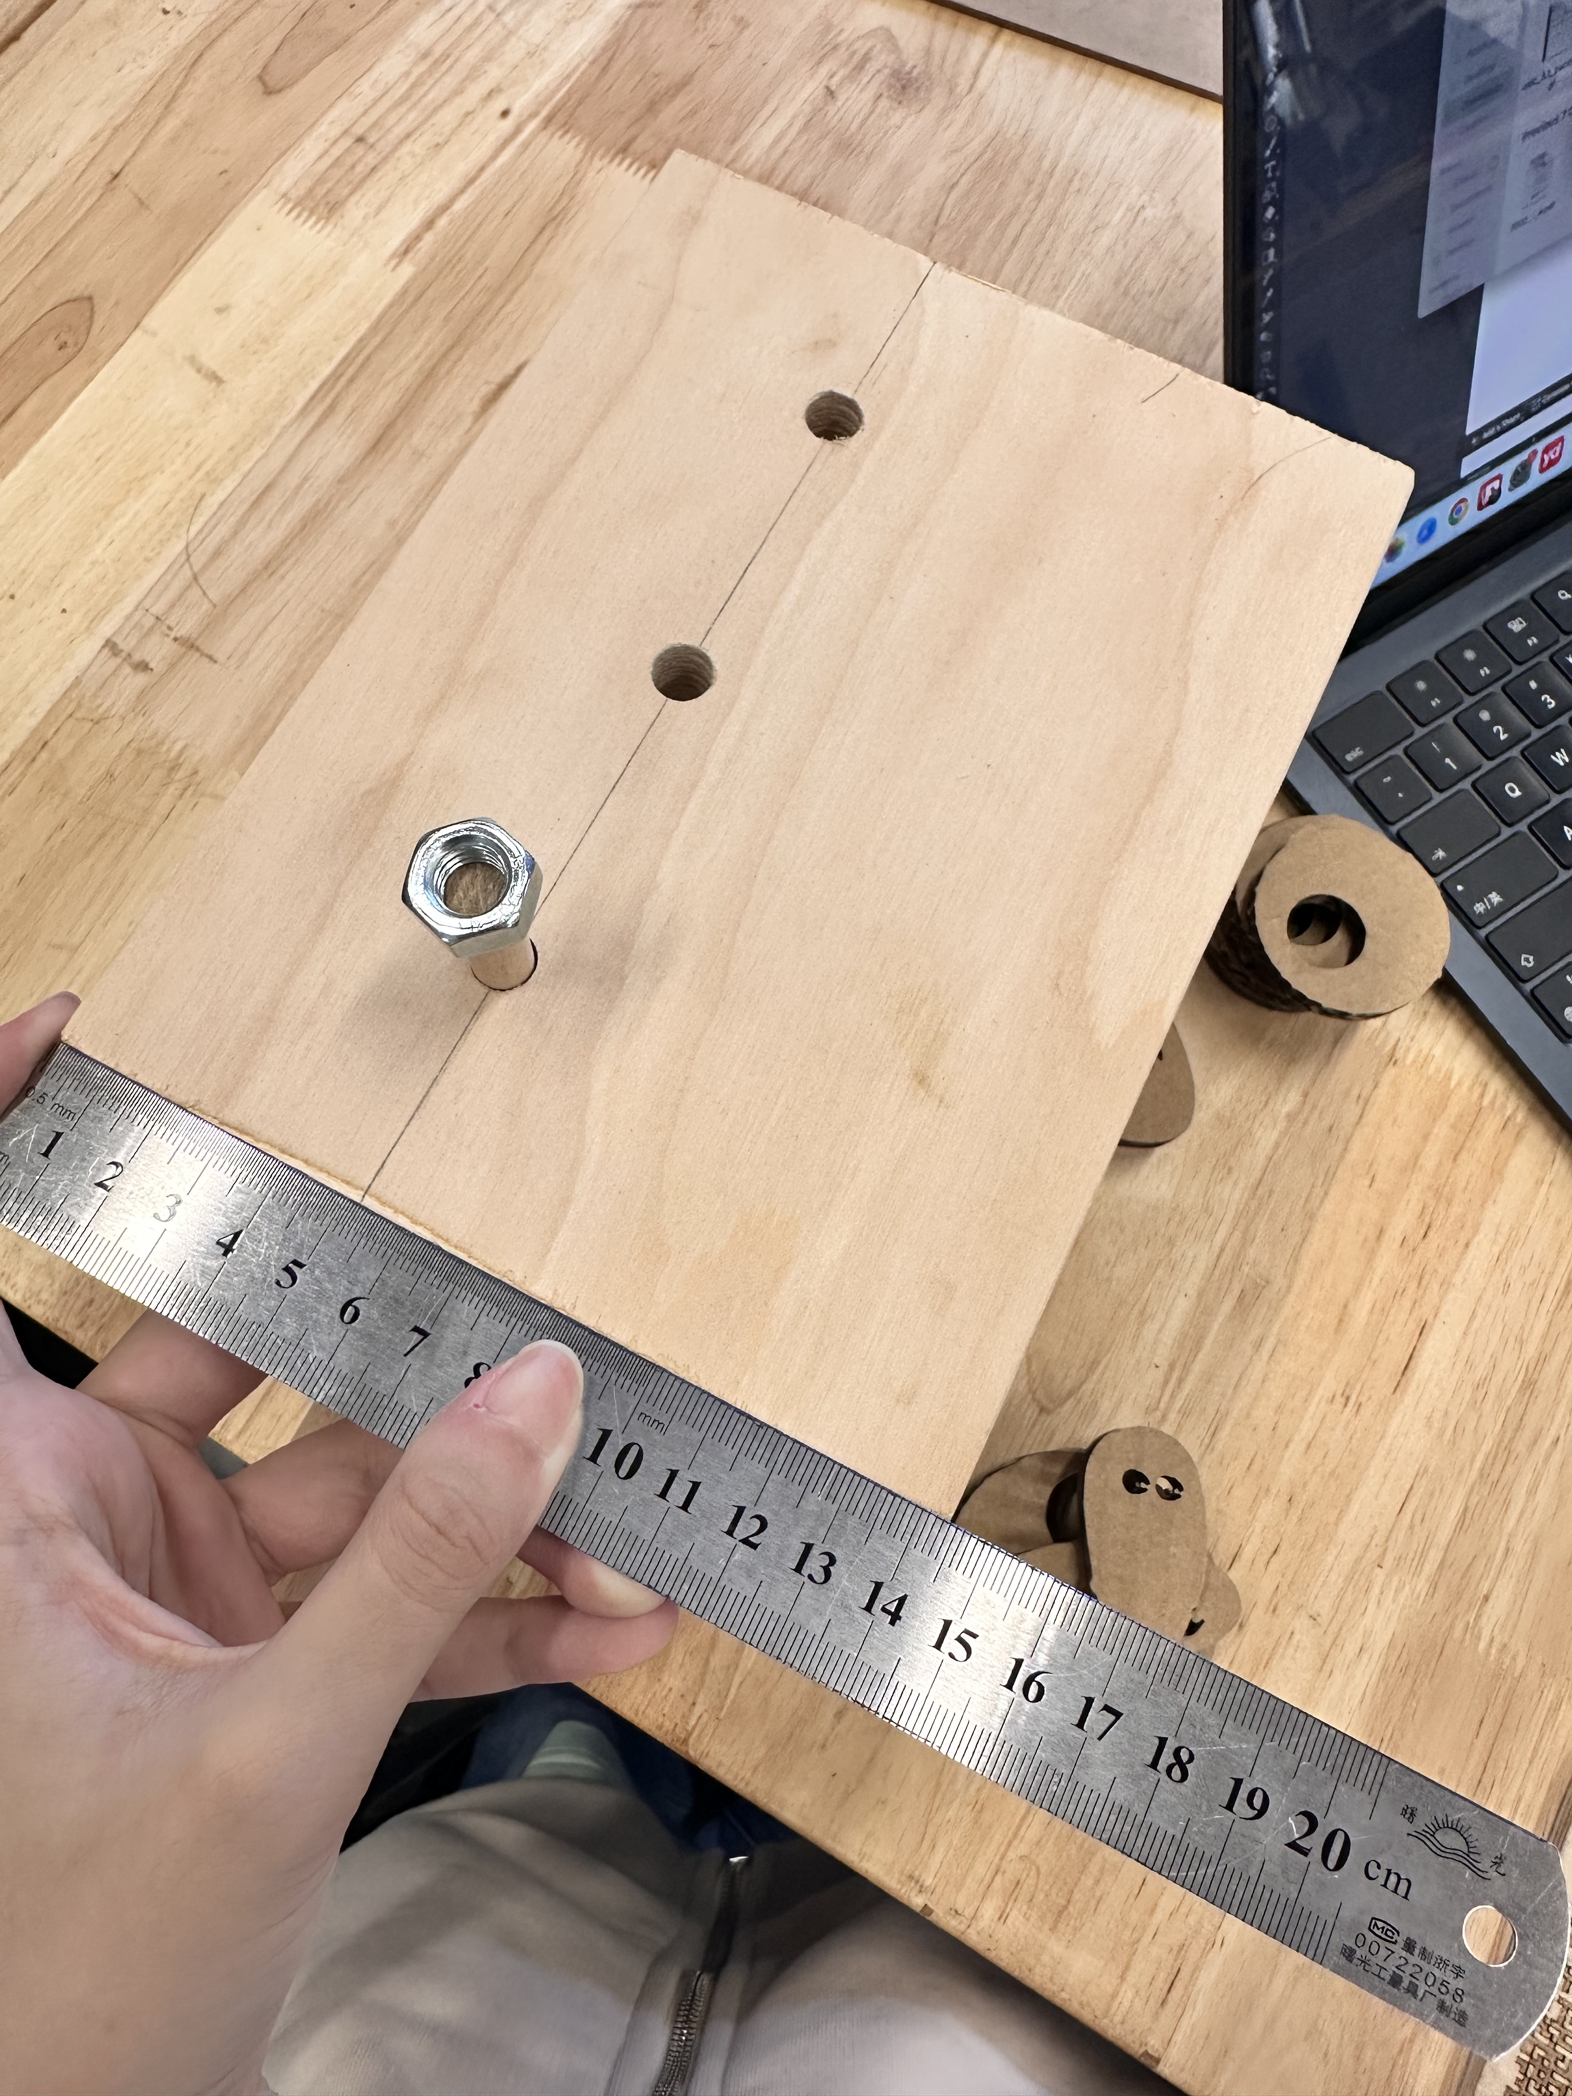
PROCESSING
I chose to present the second idea.
-I use the measurement that I got in the prototype and adding the thickness of the wood to get the actual measurement that I should use for my final design. We use the fab lab to cut out all the wood to the size that I want. Thanks to Mr. Ivan and Mr. Kilgore teaching me how to use the tools safely to get the materials that I want.
I choose to use a thick wood as the turning part because it can be more stable and easier to support the ”ghosts” on top of the wood sticks. I use the illustrator to create the circles and the ghost. I first laser cut them using cardboard to test out if they work well. I found out the ghosts are too small so I adjusted them.
-I use the illustrator to create an accurate size of my prototype, to test out if my measurement is precise.
To create the scene of my life in the top of the box I choose to use clay(Lithoplastic clay).
After cutting all materials I used wood glue and nail gun to make the box. After the box is made I measured out the place where the holes should be drilled to put the ghosts in. It was very hard to line up all the holes that are in different plane. So, we worked very hard to make them accurate.
I separated my work evenly, I chose to work on the wood part when I was at school and all the clay parts were done at home.
I first created the shapes of the trees, duck, cat, house, and person. I wait until they dry. After they dry, I use sandpaper to smooth the surface of the clay and color it with acrylic paint.

Slide 5
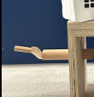
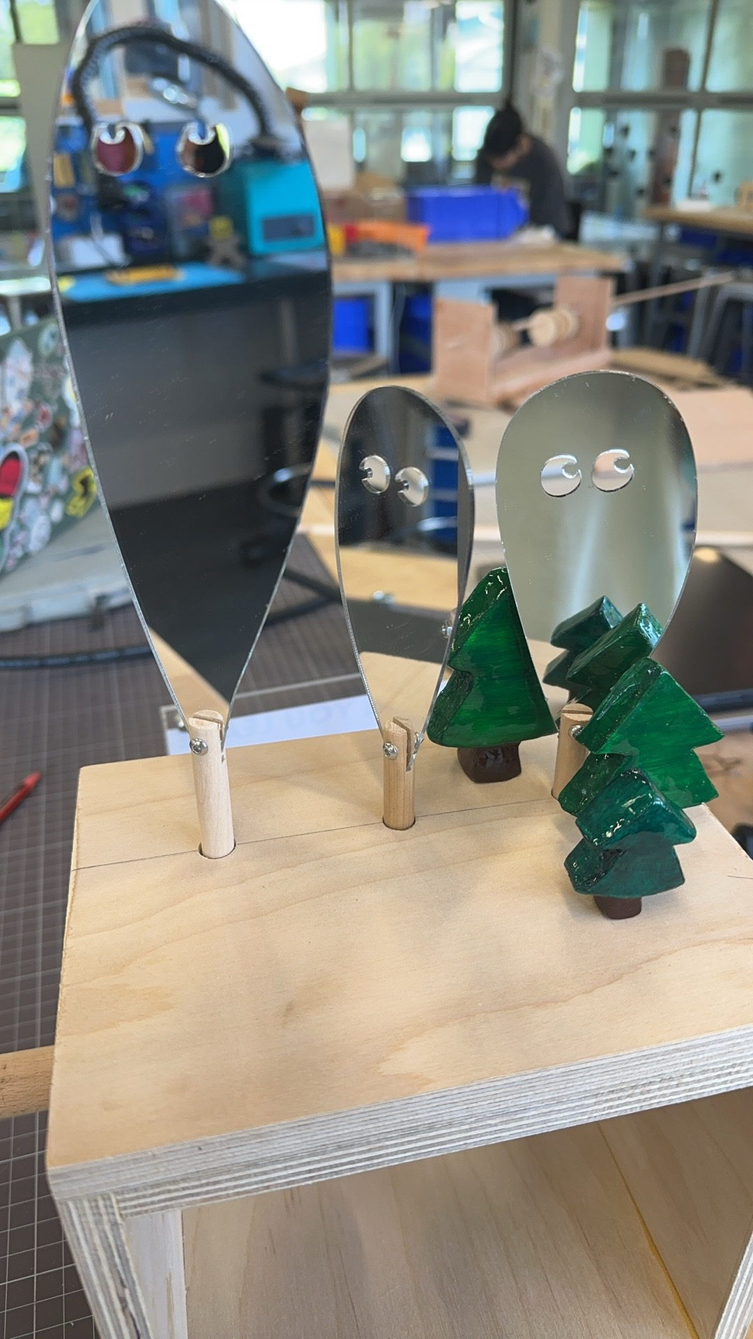
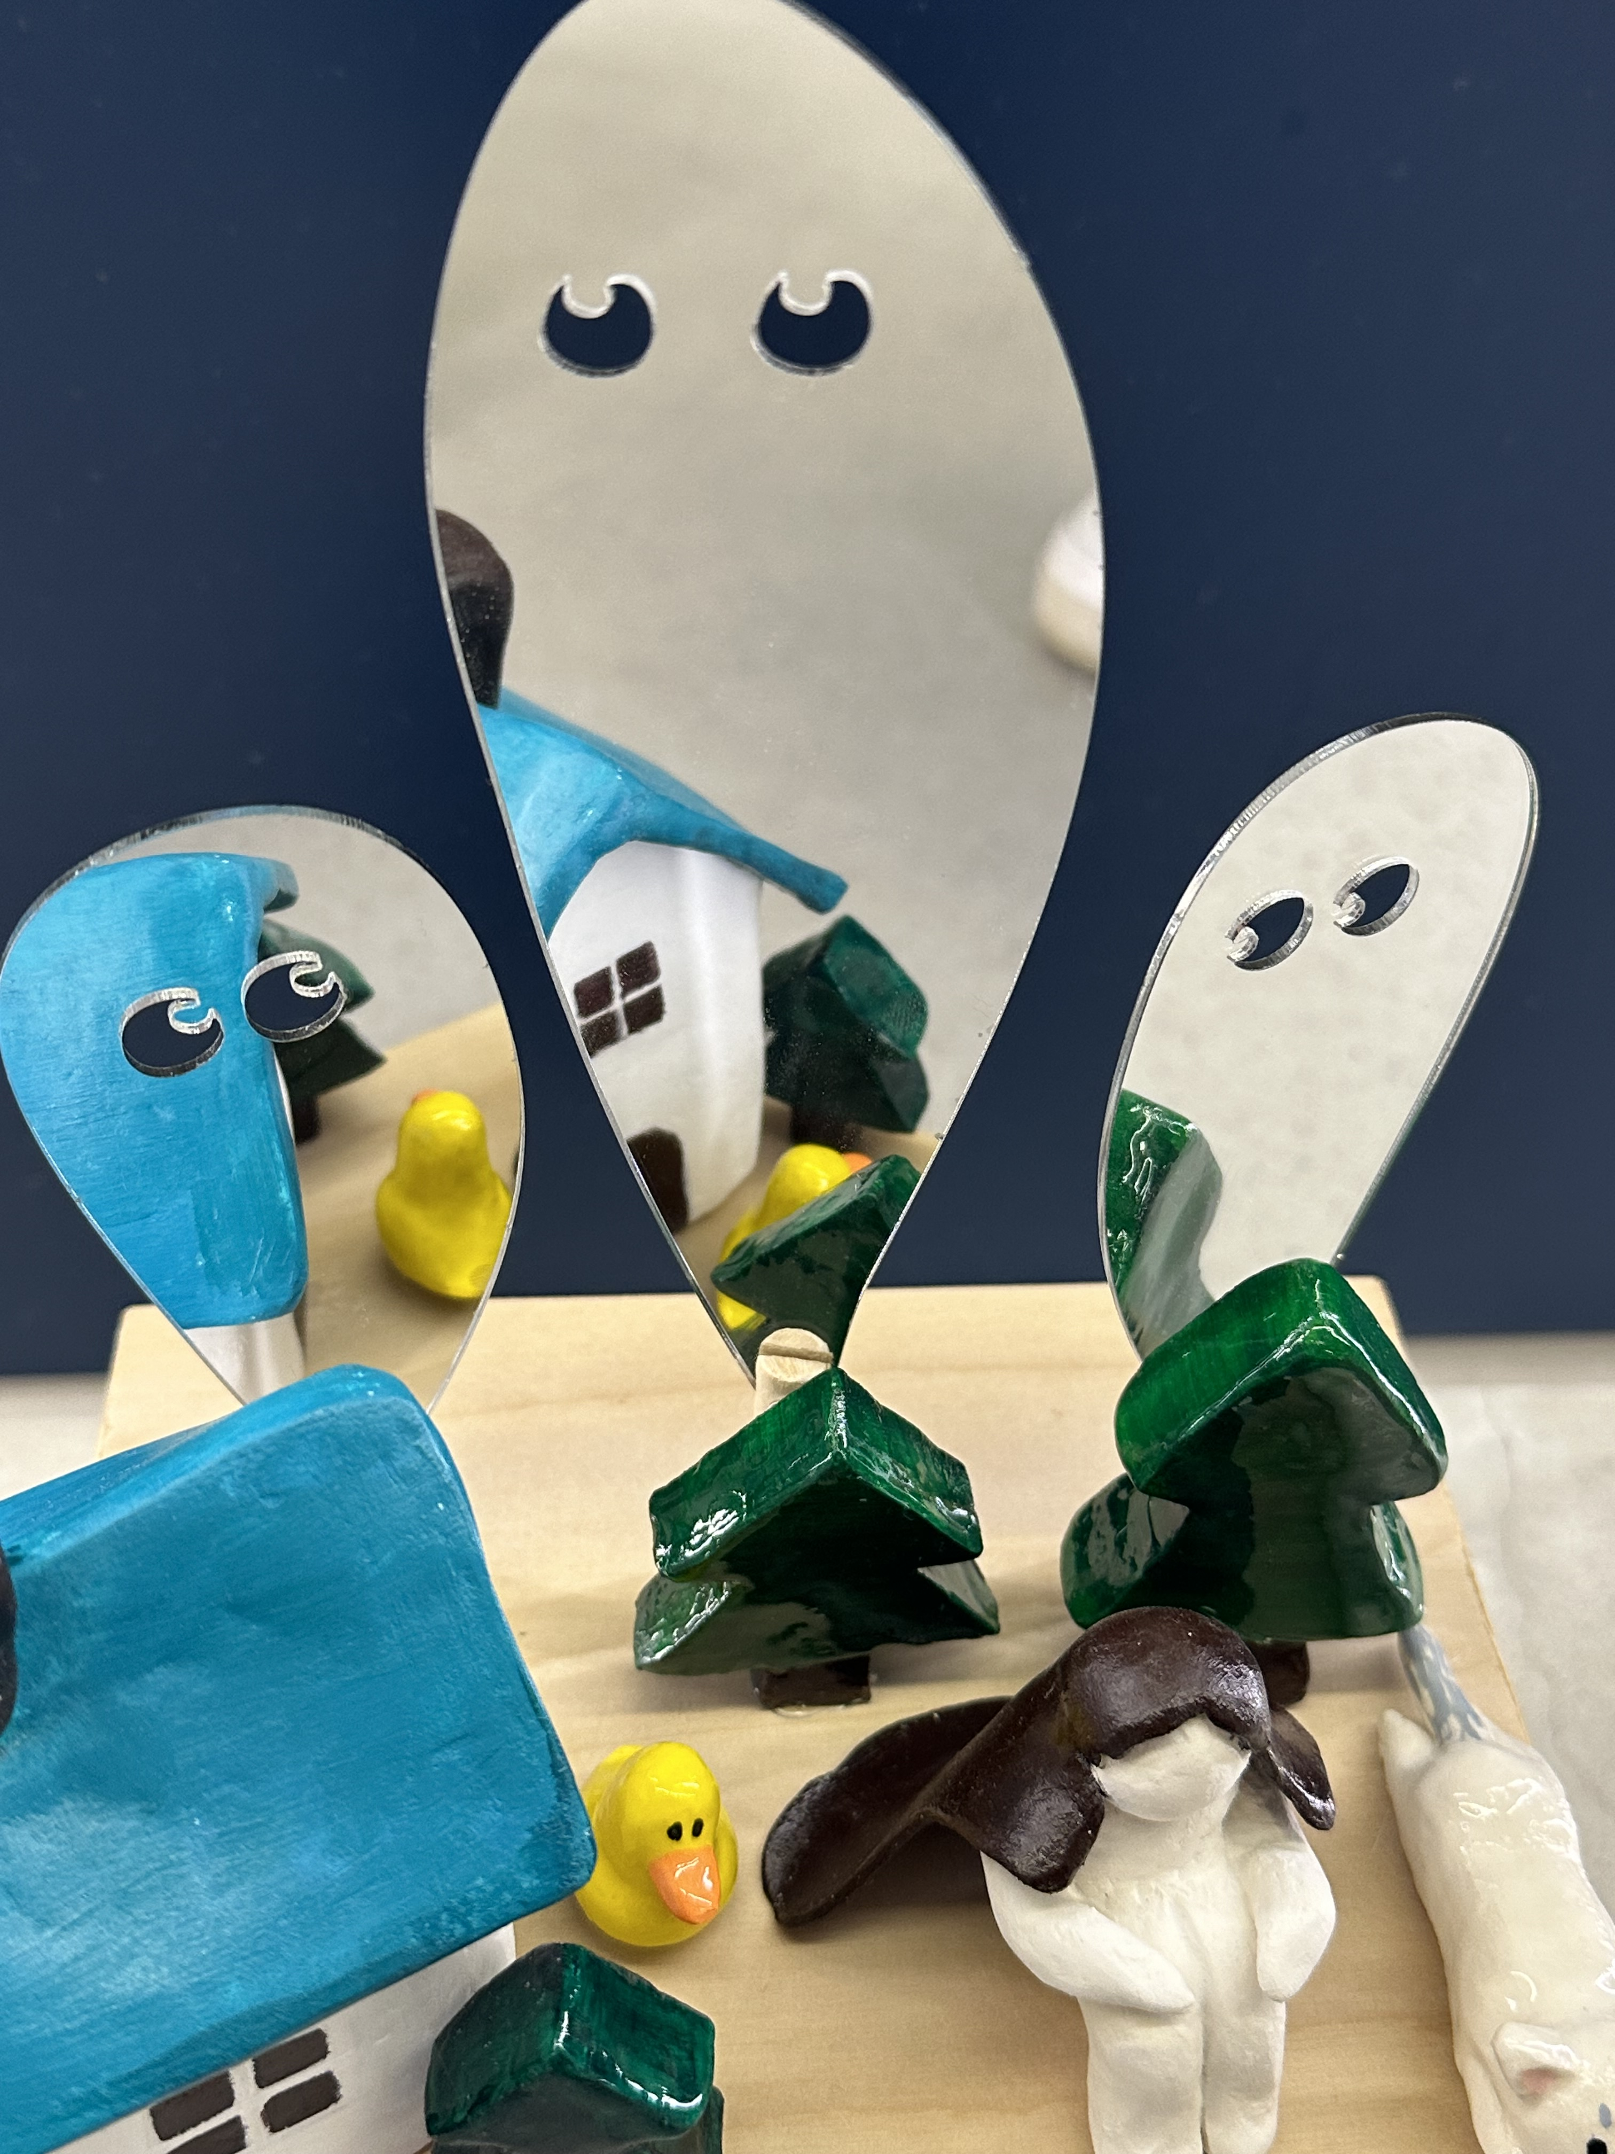
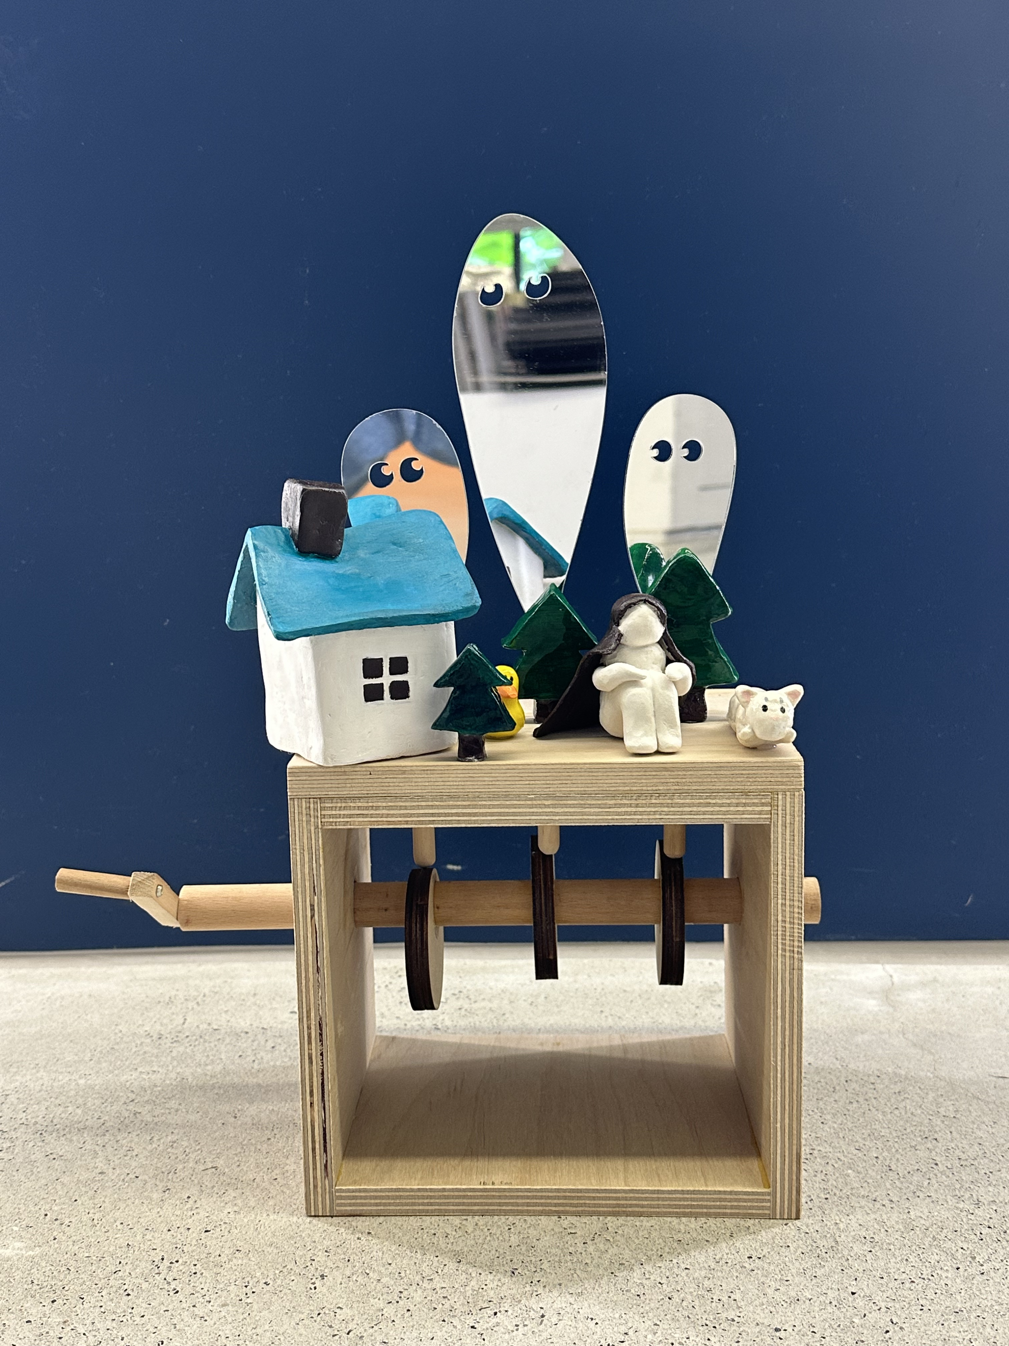
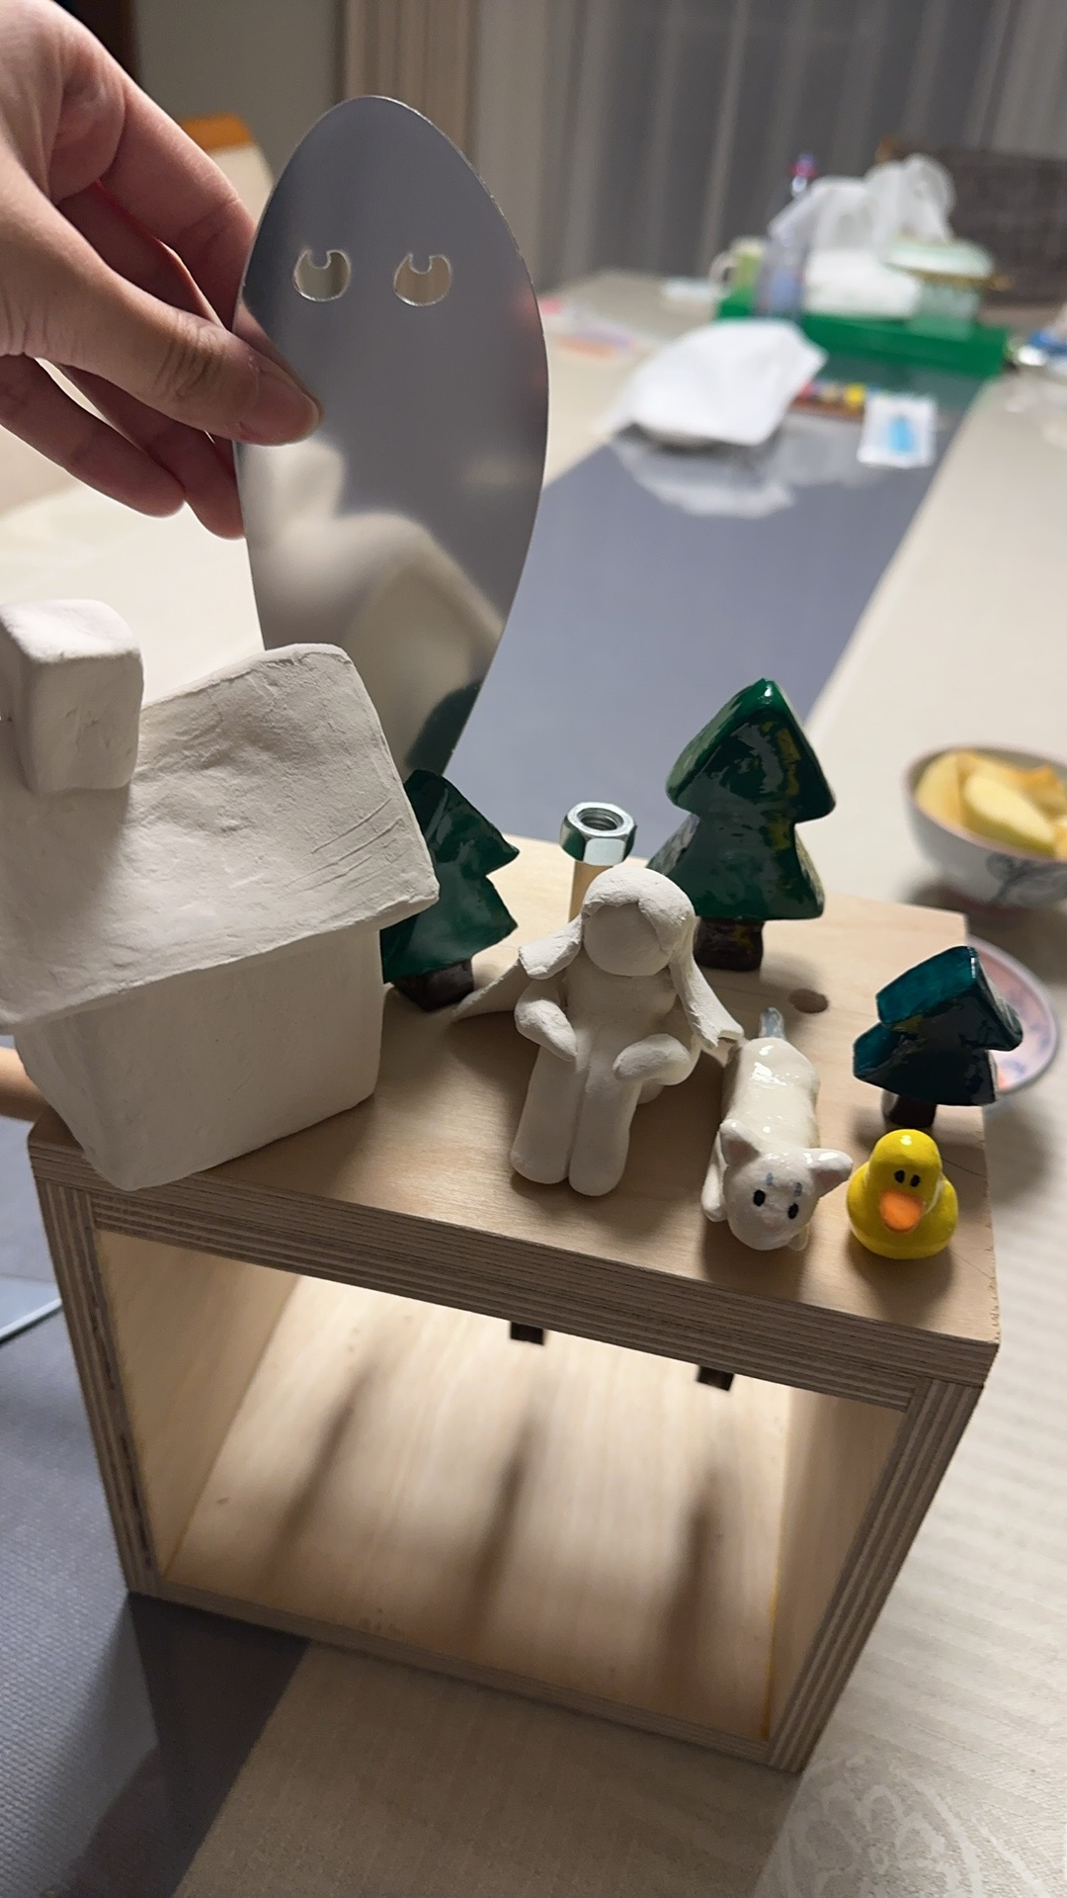
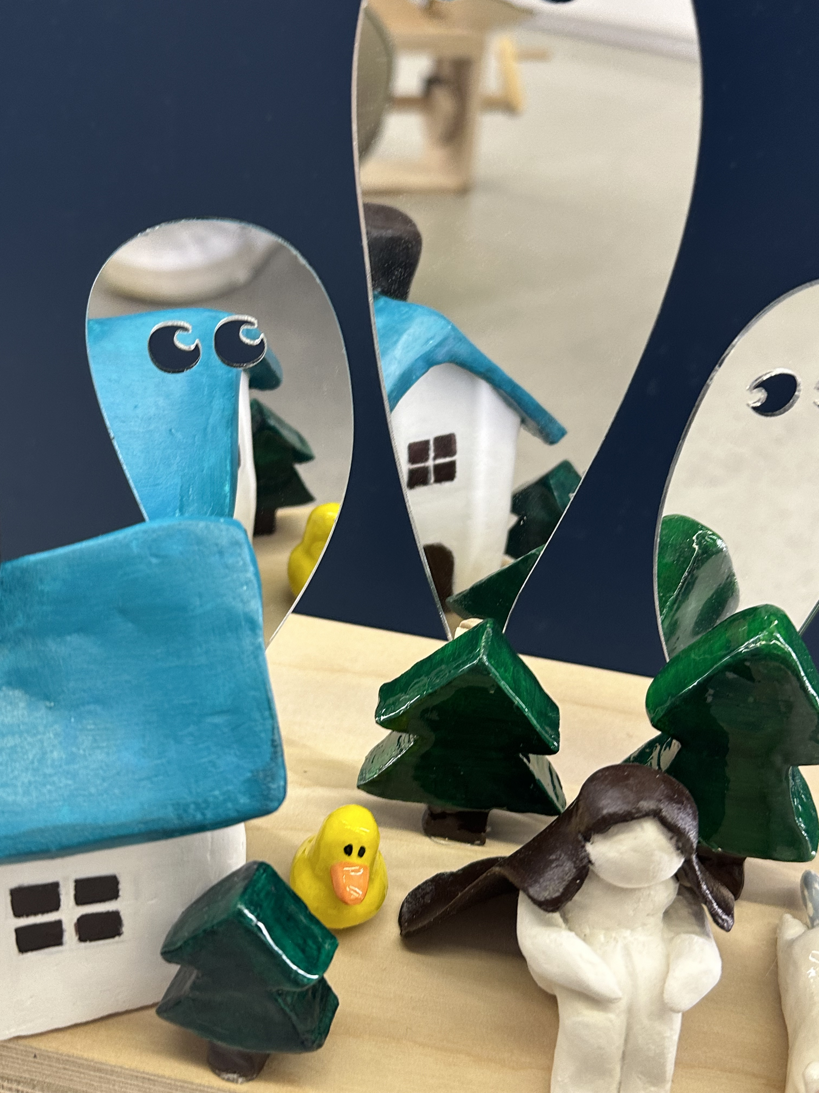
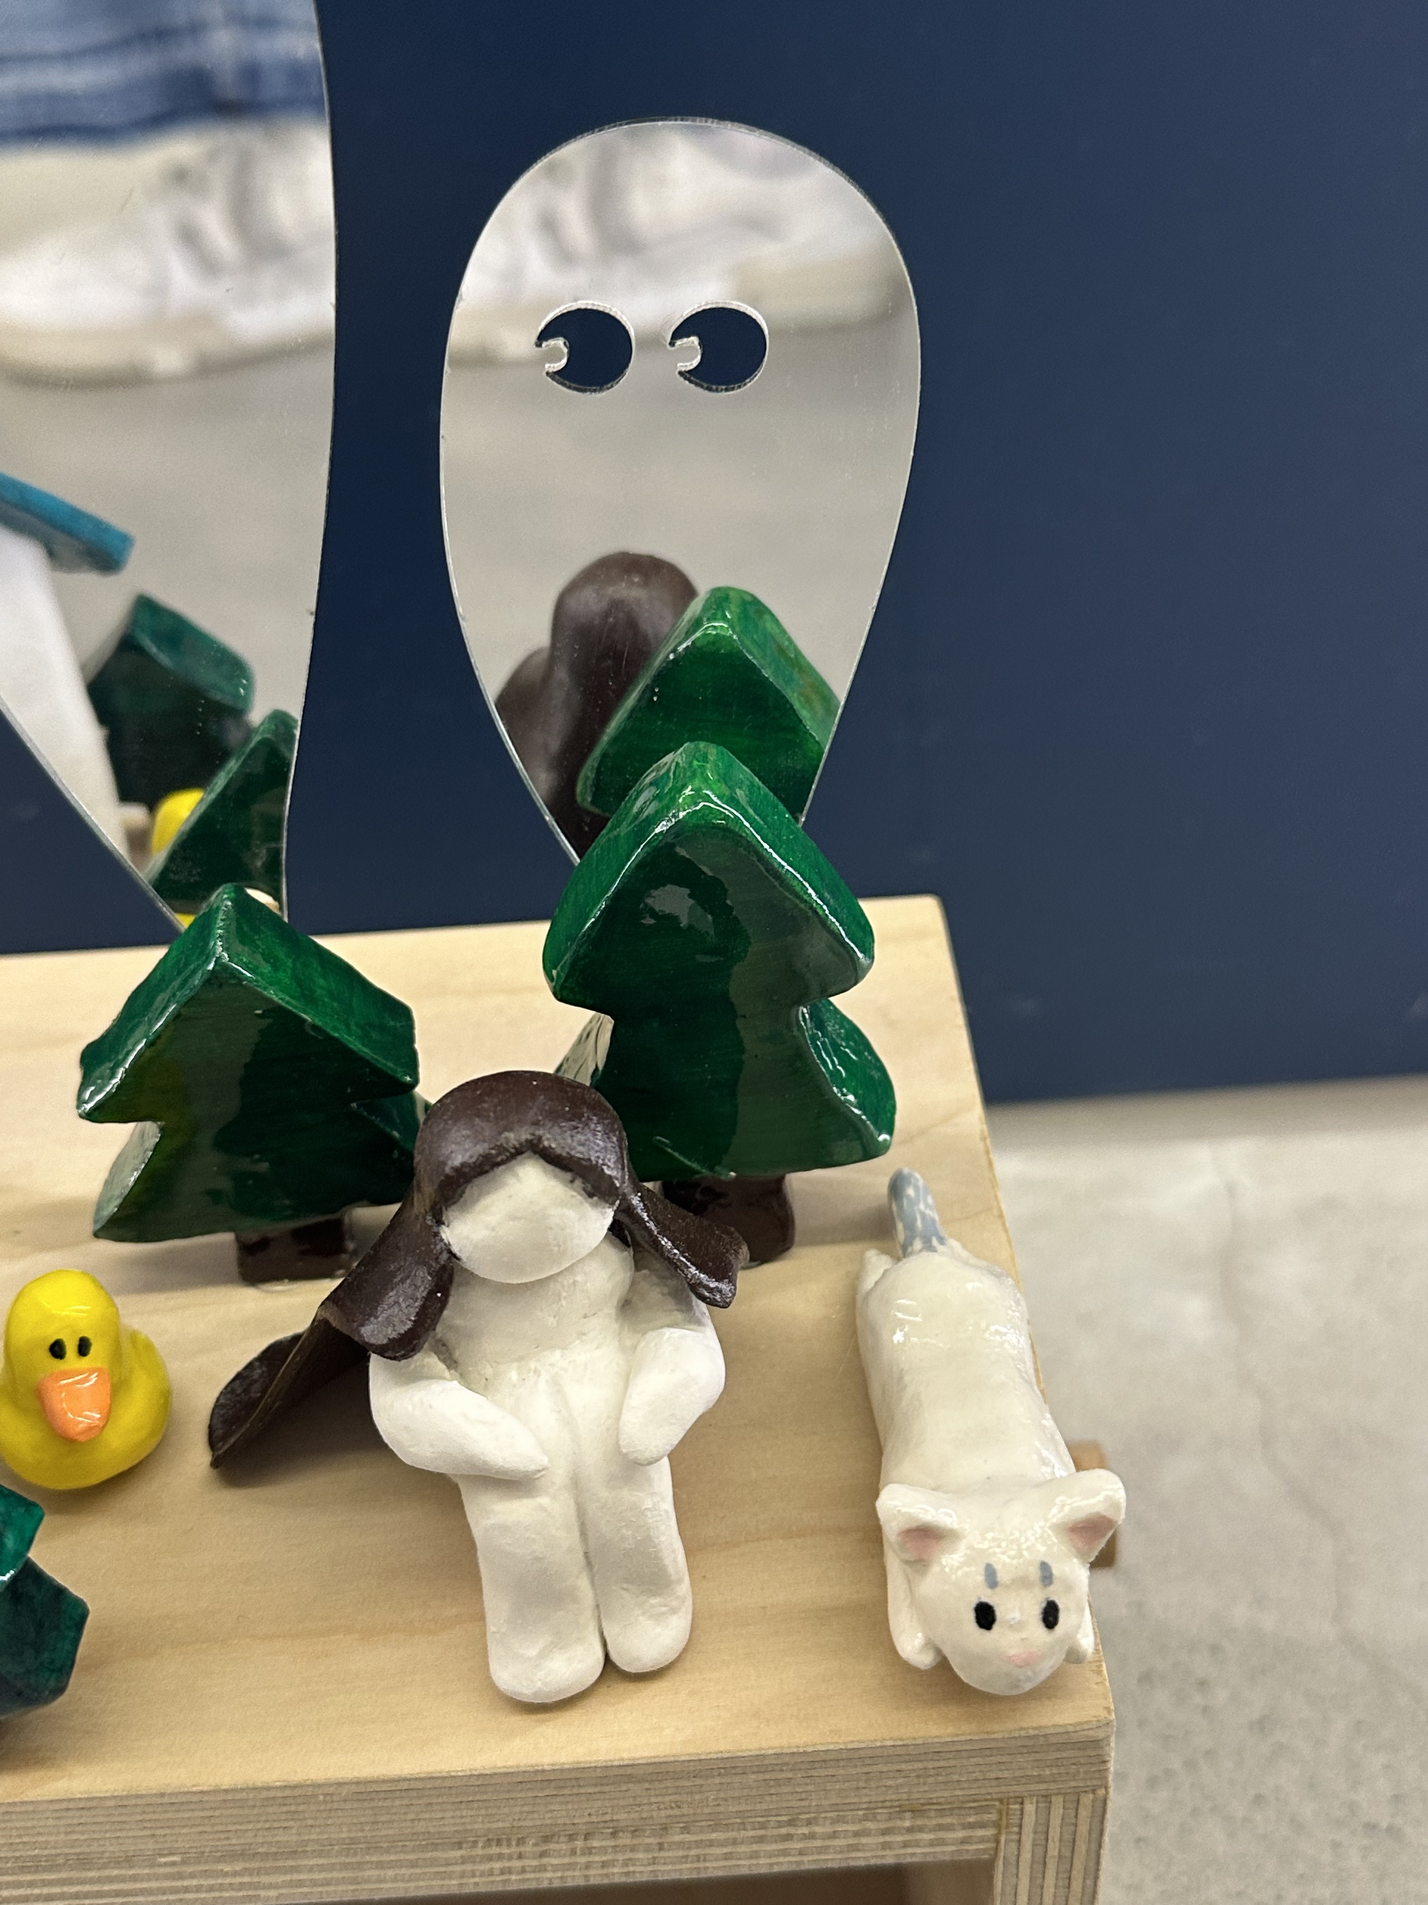
Processing + Final art project
To make the movement of the ghosts smother I made a handle in fab lab. I cutted the wood drilled them and connected them with a nail. The handle really made the movement easier.
The meaning of the clay work are :
-Duck: the sound of the word duck in Chinese is similar to my nickname
-Pine- my favourite type of tree
-Cat- I made it looks similar to my cat
-The house – the roof is painted with an aquose blue and the windows and doors I used drak brown.
After coloring all the pieces of clay I use the hot glue to glue them on the top of the box.
The strength of my project illustrated by its ability to create a deeply immersive and personal experience by combining materials and movement. Clay and wood introduces texture, grounding the experience while contrasting with the mirrors' effect. The automaton mechanism allows the "ghost" to move freely, symbolizing the feeling of being chased by one's fears, adding a lifelike and unpredictable quality. The strength of my work lies in its ability to engage viewers on a personal and emotional level.
My project is about how my inner fears connect with the imagined scenes of my life. It explores the idea of "scaring oneself" and shows that these fears come from within. By using mirrors, viewers see their own reflections, showing that these fears are illusions they create themselves. This gives people a chance to experience and better understand what it means to be scared by their own thoughts.
I grew during this project because I learned how to utilize machines in a fab lab and how to effectively combine different materials to get a successful final product.
Something that can be done better is I could create a background to make the scene more complete

